Slide 1


<Name>
<Date>

Slide 2

Outline
Executive Summary
Introduction
Methodology
Results
Conclusion

Slide 3
Executive Summary
Summary of methodologies
Data collection using SpaceX API
Data collection using Web Scraping from Wikipedia
Data Wrangling
Exploratory Data Analysis using SQL queries
Exploratory Data Analysis using Plots/Visualizations
Interactive Location Maps using Folium
Dashboard with Plotly Dash
Prediction using Machine Learning
Summary of all results
Results from Exploratory Data Analysis
Insights from Interactive Visualizations
Predictive Analytics

Slide 4
Introduction
Project background and context
Space X advertises Falcon 9 rocket launches on its website with a cost of 62 million dollars. Other providers cost upward of 165 million dollars each, much of the savings is because Space X can reuse the first stage. If we can determine if the first stage will land, we can determine the cost of a launch. This information can be used if an alternate company wants to bid against space X for a rocket launch. In this lab, you will create a machine learning pipeline to predict if the first stage will land given the data from the preceding labs.
Problems you want to find answers
Factors that determine if the rocket will land successfully.
Interaction amongst various variables that determine the success rate of a successful landing.
Operating conditions that needs to be in place to ensure a successful landing program.
A reliable method for accurately predicting the outcomes of a successful launch.

Slide 5

Section 1

Slide 6
Methodology
Executive Summary
Data collection methodology:
Data was collected using python from SpaceX API and web scraping from wikipedia
Perform data wrangling
Data was processed to remove null values and other preprocessing calculations, and the target variable was determined
Perform exploratory data analysis (EDA) using visualization and SQL
Perform interactive visual analytics using Folium and Plotly Dash
Perform predictive analysis using classification models
Models were built using sklearn, hyperparameters were tuned using GridSearchCV and evaluated using cross-validation (CV) score.

Slide 7
Data Collection
Two mutually-exclusive sources were used to collect the data:
- SpaceX REST API (using API calls)
- Falcon 9 Wikipedia page (using Web scraping tools)
SpaceX REST API
API calls
Csv files containing data
Data formatting
Falcon 9 Wikipedia page
Get requests

Slide 8
Data Collection – SpaceX API
Key Details
Overall objective: Use SpaceX REST API to extract the Falcon9 data and store it in cvs format.
Tools used: Python notebook and associated API tools.
URL of the SpaceX API: https://api.spacexdata.com/v4/launches/past
GitHub URL of the SpaceX data collection notebook: https://github.com/PSCPU/Falcon-9-launch/blob/main/Data%20Collection%20API.ipynb
Get request Falcon9 Launch data from SpaceX API
Decode the response as json and convert to dataframe
Use API again to get information about the launches using
the IDs for each launch from rocket, payload, launch and cores columns
Create empty lists and store the data from requests to lists
Combine the columns names (keys) and the associated data
(values) into a dictionary
Create the pandas dataframe from the dictionary
Save the dataframe to a csv file

Slide 9
Data Collection - Scraping
Key Details
Overall objective: Scrape the data from target table on Falcon 9 Wikipedia page and store it in cvs format.
Tools used: Python notebook and associated web scraping tools.
Scraped Falcon 9 Wikipedia page https://en.wikipedia.org/wiki/List_of_Falcon/_9/_and_Falcon_Heavy_launches
GitHub URL of the web scraping notebook: https://github.com/PSCPU/Falcon-9-launch/blob/main/Data%20Collection%20with%20Web%20Scraping.ipynb
HTTP GET method: request the Falcon9 Launch HTML page
Beautifulsoup object from the Wikipedia page
find all tables on the wiki page
Check the contents of the target table
Extract the column names of the target table
Create a dictionary with keys from the extracted column names
Fill dictionary with launch records extracted from table rows
Create the pandas dataframe from the dictionary
Save the dataframe to a csv file

Slide 10
Data Wrangling
Launches at each Falcon 9 launch site
Create a landing outcome label from outcome column
Determine the success rate
Export the processed data to csv
Load Dataframe
Handle null values
Calculations
Orbit type and occurrence
Mission outcome per orbit type
GitHub URL: https://github.com/PSCPU/Falcon-9-launch/blob/main/EDA.ipynb

Slide 11
EDA with Data Visualization
Following charts were used for visualizing the relationships between different feature variables:
Scatterplots for discrete variables:
a. Flight number versus - payload mass
- launch site
- orbit type
c. Launch site versus payload mass
d. Payload versus orbit type
2. Bar plot for success rate versus orbit type (one continuous and one discrete variable)
3. Line plot for success rate versus year (periodically incremental variable)
GitHub URL: https://github.com/PSCPU/Falcon-9-launch/blob/main/EDA-Visualization.ipynb

Slide 12
EDA with SQL
SQL queries were performed to accomplish the following tasks:
Display the names of the unique launch sites in the space mission
Display 5 records where launch sites begin with the string 'CCA’
Display the total payload mass carried by boosters launched by NASA (CRS)
Display average payload mass carried by booster version F9 v1.1
Date when the first succesful landing outcome in ground pad was achieved.
Boosters with success in drone ship and payload > 4000 but < 6000
Total number of successful and failure mission outcomes
Names of the booster versions which have carried the maximum payload mass
Month names, failure landing in drone ship, booster versions, launch_site for 2015.
Rank the successful landing outcomes between 04-06-2010 and 20-03-2017 in descending order.
GitHub URL: https://github.com/PSCPU/Falcon-9-launch/blob/main/EDA-SQL.ipynb

Slide 13
Marker for each launch site on the site map
Build an Interactive Map with Folium
Following map objects were created and added to the folium map:
Circle (for a highlighted circle area on a specific coordinate)
Marker (to mark each launch site on the site map)
Marker clusters (to indicate many launch records with the exact same location)
MousePosition (to get coordinate for a mouse over a point on the map)
PolyLine (to plot distance lines of launch sites from the proximitines)
GitHub URL: https://github.com/PSCPU/Falcon-9-launch/blob/main/Folium-maps.ipynb

Slide 14
Build a Dashboard with Plotly Dash
Following plots/graphs and interactions have been added to a dashboard:
Dropdown list (to enable Launch Site selection)
Pie chart (to show the total successful launches count for all sites)
Scatter chart (to show the correlation between payload and launch success)
GitHub URL: https://github.com/PSCPU/Falcon-9-launch/blob/main/spacex_dash_app.py

Slide 15
Predictive Analysis (Classification)
Load the processed Falcon 9 data in a pandas dataframe
Performance of the following four classification methods were compared after performing hyperparameter optimization:
Logistic Regression
Support Vector Machines (SVM)
Decision Tree Classifiers
K-Nearest Neighbor (KNN)
Create a Pandas series of the column class and assign it to Y
Standardize the data X containing features
Split the data into training (80%) and test (20%) sets
Create a logistic regression object and perform grid search
Evaluate the best hyperparameters and the CV score
Repeat the process for SVM, Decision tree and KNN classifiers
Compare the CV scores to find the best performing model
15
GitHub URL: https://github.com/PSCPU/Falcon-9-launch/blob/main/spacex_dash_app.py

Slide 16
Results
Exploratory data analysis results
Interactive analytics demo in screenshots
Predictive analysis results

Slide 17

Section 2

Slide 18
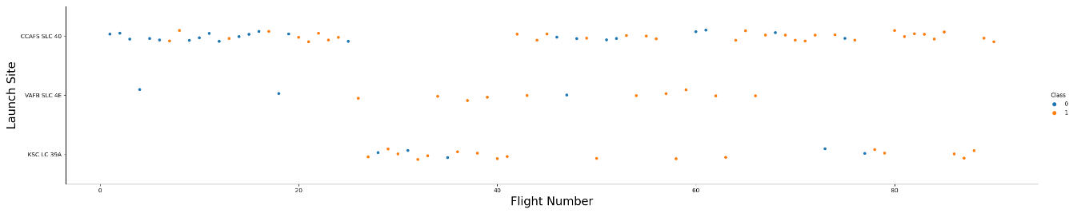
Flight Number vs. Launch Site
Launches from CCAFS SLC-40 station are significantly higher than other stations.

Slide 19
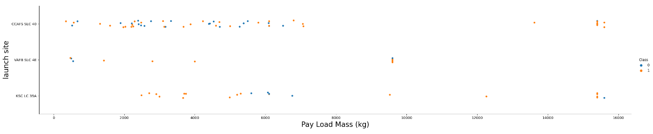
Payload vs. Launch Site
Very high payloads are not launched at VAFS-SLC-4E station.
The proportion of high payload mass launches is significantly smaller than low or moderate payload mass.

Slide 20
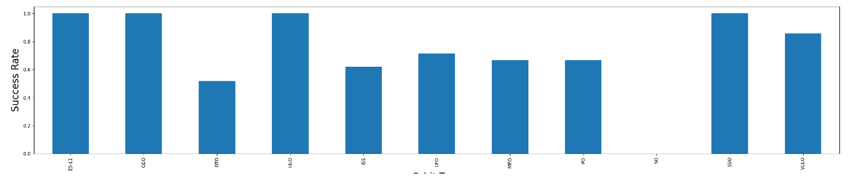
Success Rate vs. Orbit Type
Orbit
Four orbits have almost 100% success rate.
One orbit has 0% success rate.

Slide 21
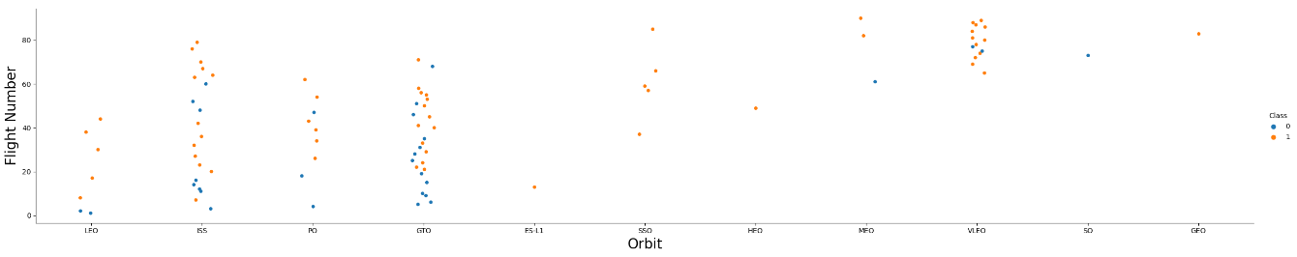
Flight Number vs. Orbit Type
For LEO orbit the Success appears related to the number of flights.
On the other hand, there seems to be no relationship between flight number when in GTO orbit.

Slide 22
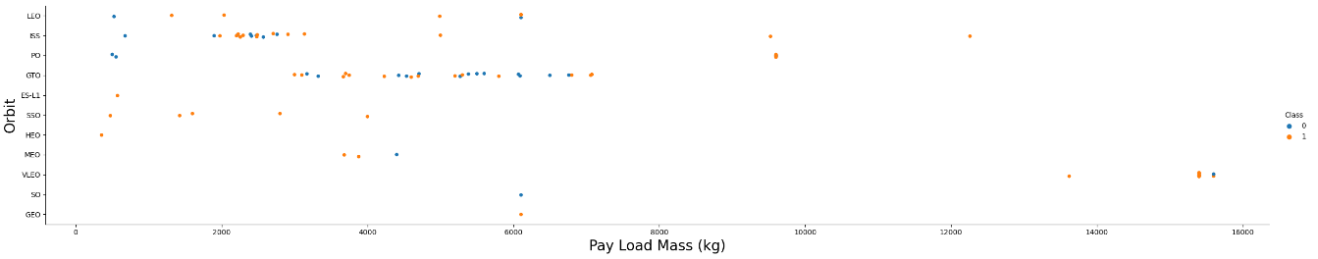
Payload vs. Orbit Type
VLEO orbit carries the high pay load mass.
Low payload mass is generally carried by LSS
Moderate payload mass is generally carried by GTO
LSS and GTO together carry majority of the medium and low payload masses

Slide 23
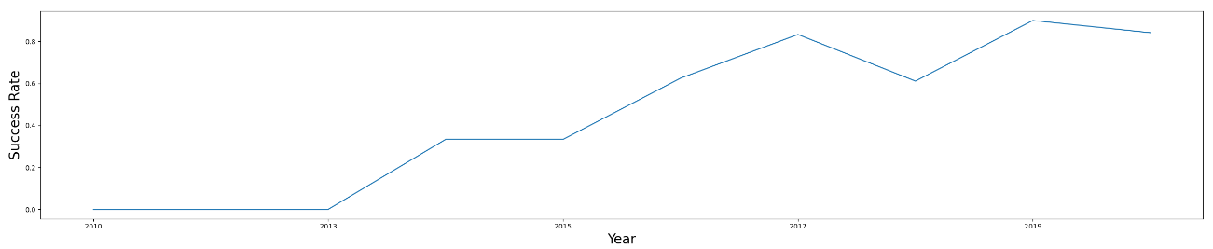
Launch Success Yearly Trend
Barring a small dip in 2018 and 2020, the yearly average success rate has risen over the years.
The highest success rate of close to 90% was observed in 2019.

Slide 24
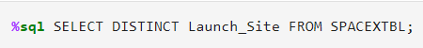
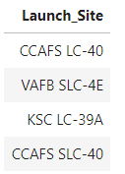
All Launch Site Names
Query:
Result:
Four launch sites were used in total

Slide 25
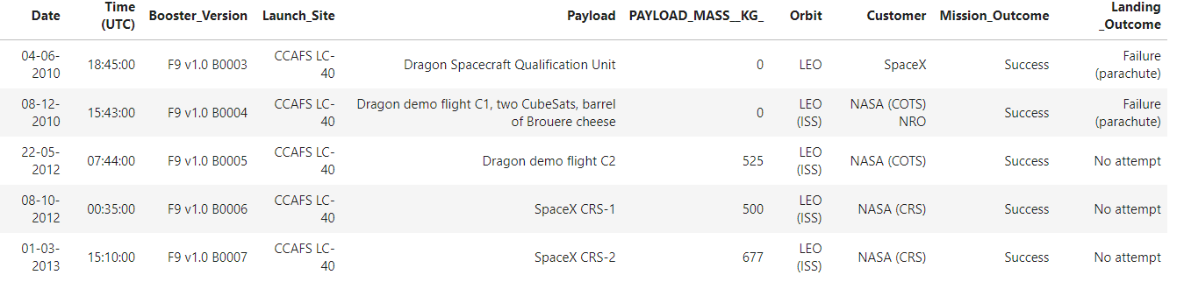
Launch Site Names Begin with 'CCA'
Query:
Result:
All these older launches from CCAFS-LC-40 used the LEO orbit type.
Some of these earlier launches did not attempt landing.

Slide 26
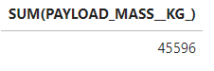
Total Payload Mass
Query:
Result:
Total of 45596 kg payload mass was carried by boosters launched by NASA (CRS)

Slide 27
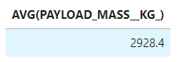
Average Payload Mass by F9 v1.1
Query:
Result:
An average of 2928.4 kg was carried by F9 v1.1 boosters

Slide 28
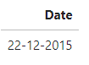
First Successful Ground Landing Date
Query:
Result:
The first successful ground landing occurred on 22 December 2015

Slide 29
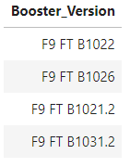
Successful Drone Ship Landing with Payload between 4000 and 6000
Query:
Result:
Four F9 FT booster versions – B1022, B1026, B1021.2 and B.1031.2 fulfilled the query criteria

Slide 30
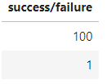
Total Number of Successful and Failure Mission Outcomes
Query:
Result:
100 successful and 1 failed missions occured

Slide 31
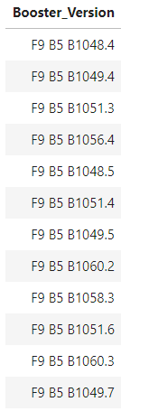
Boosters Carried Maximum Payload
Query:
Result:
12 distinct booster versions carried the maximum payload

Slide 32
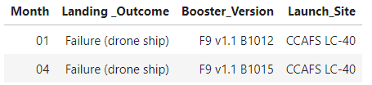
2015 Launch Records
These are the records of failed landings on drone ships, along with the booster version and launch
site

Slide 33
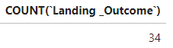
Rank Landing Outcomes Between 2010-06-04 and 2017-03-20
34 landing outcomes between the date 2010-06-04 and 2017-03-20.

Slide 34

Section 3

Slide 35
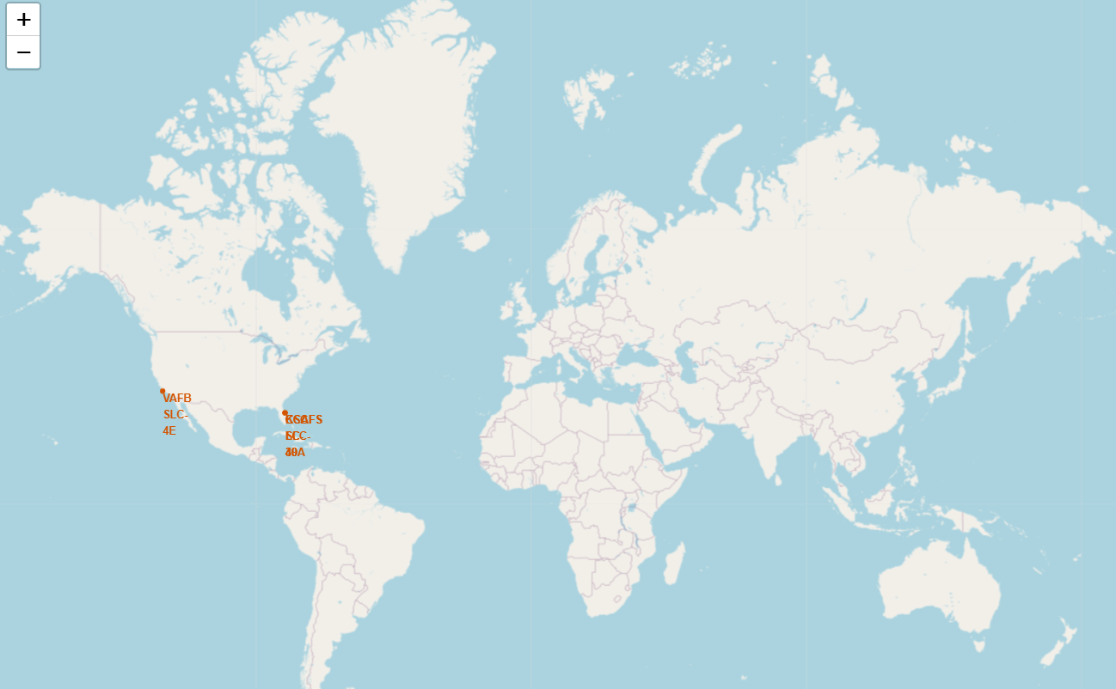
Folium Map with marked Launch Sites
Launch sites marked in orange on the Folium map

Slide 36
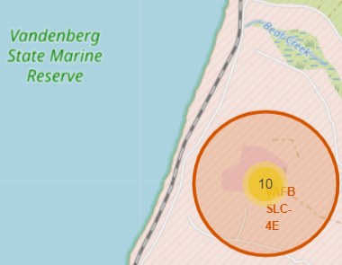
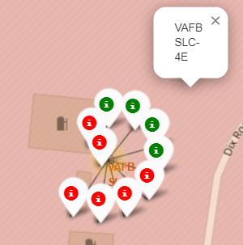
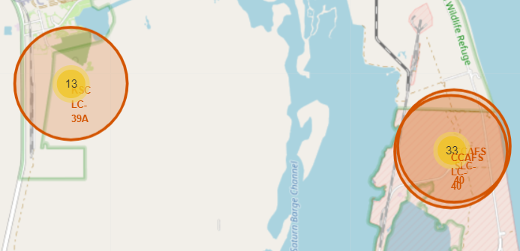
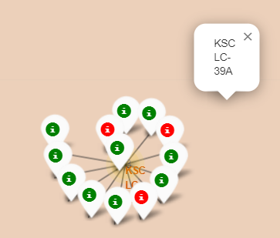
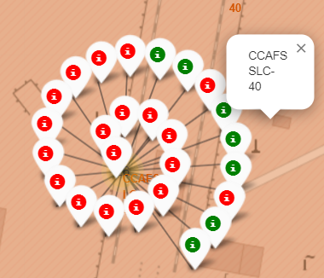
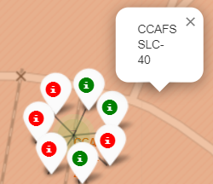
Success/failed launches for each site on the map
California site
Florida sites
Red indicates successful launch, whereas green indicates failed launch

Slide 37

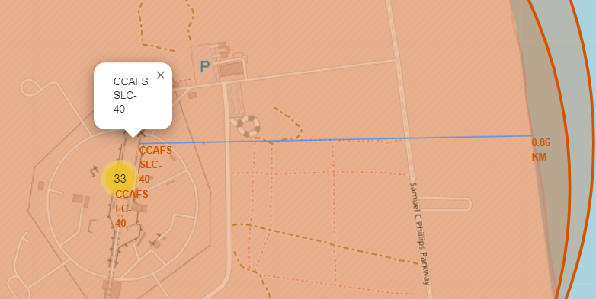
Proximity analysis using Folium
Launch sites are close to coastlines

Slide 38

Section 4

Slide 39

Success percentage achieved by each launch site

Slide 40

Launch site with the highest launch success ratio
KSC LC-39A achieved the highest success rate

Slide 41

<Dashboard Screenshot 3>
Low rated payload has higher success rate

Slide 42

Section 5

Slide 43
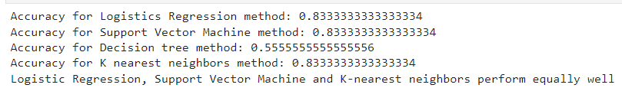
Classification Accuracy

Slide 44

Confusion Matrix
Decision tree classifier r can distinguish between the different classes. The major problem is the false positives.

Slide 45
Conclusions
Logistic regression, support vector machines and decision tree classifiers provide equal accuracy, as evidenced from their cross-validation scores.
KSC LC-39A achieved the highest success rate.
Older launches from CCAFS-LC-40 used the LEO orbit type.
Some of these earlier launches did not attempt landing.
Very high payloads are not launched at VAFS-SLC-4E station.
The proportion of high payload mass launches is significantly smaller than low or moderate payload mass.

Slide 46


